Slide 1
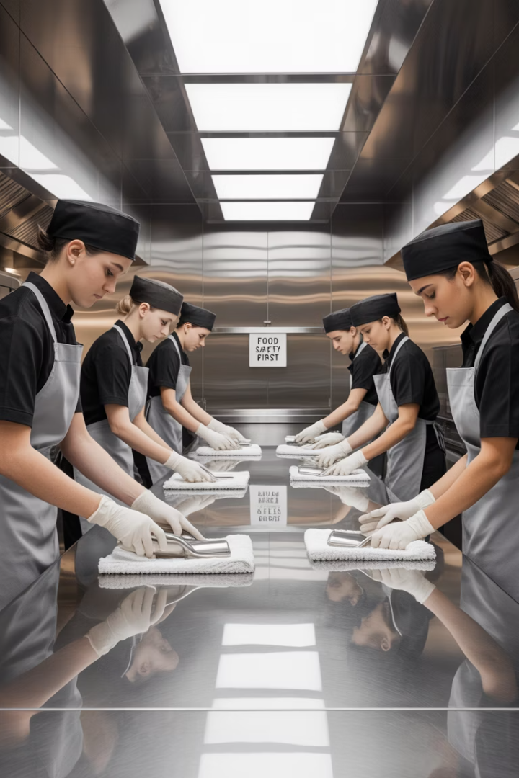
Essential Cleaning & Sanitizing Practices
Proper sanitation is critical to prevent foodborne illness and maintain compliance with health regulations.
This training will equip you with essential knowledge and practical skills for maintaining a safe, clean food service environment.

Slide 2
Cleaning vs. Sanitizing:
Understanding the Difference
Cleaning
Sanitizing
Removes visible food residue, dirt, and debris from surfaces.
Reduces pathogens to safe levels after cleaning.
Uses chemicals or heat to kill remaining microorganisms.
Prepares surfaces for the sanitizing step.
Uses detergents to break down and remove soils.
Must be done after cleaning, never before.

Slide 3
Factors That Affect Cleaning Effectiveness
Water Hardness
Water Temperature
Hard water reduces cleaner effectiveness and leaves mineral deposits.
Hot water improves cleaning but may set protein-based soils if too hot.
Agitation
Scrubbing or pressure helps dislodge stubborn debris from surfaces.
Surface Type
Smooth, nonabsorbent surfaces are easier to clean properly.
Contact Time
Cleaners need sufficient time to break down soils effectively.

Slide 4
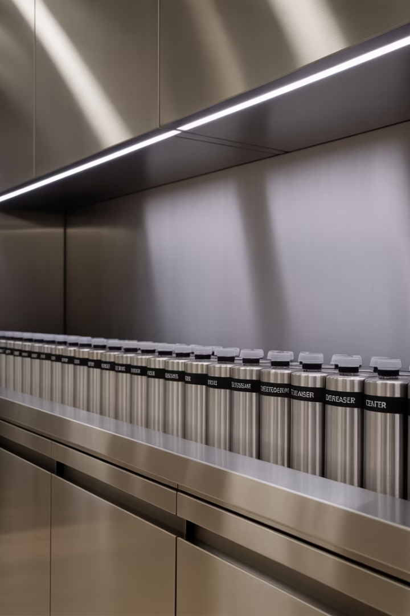
Types of Cleaners for Different Tasks
Detergents
All-purpose cleaners for most surfaces. They remove fresh dirt and light soils.
Degreasers
Specially formulated to cut through grease. Ideal for ovens, grills, and hoods.
Delimers
Acid-based cleaners that remove mineral deposits and hard water scale from equipment.
Abrasive Cleaners
Contain gritty particles to scrub away heavy buildup. Use carefully to avoid damage.

Slide 5
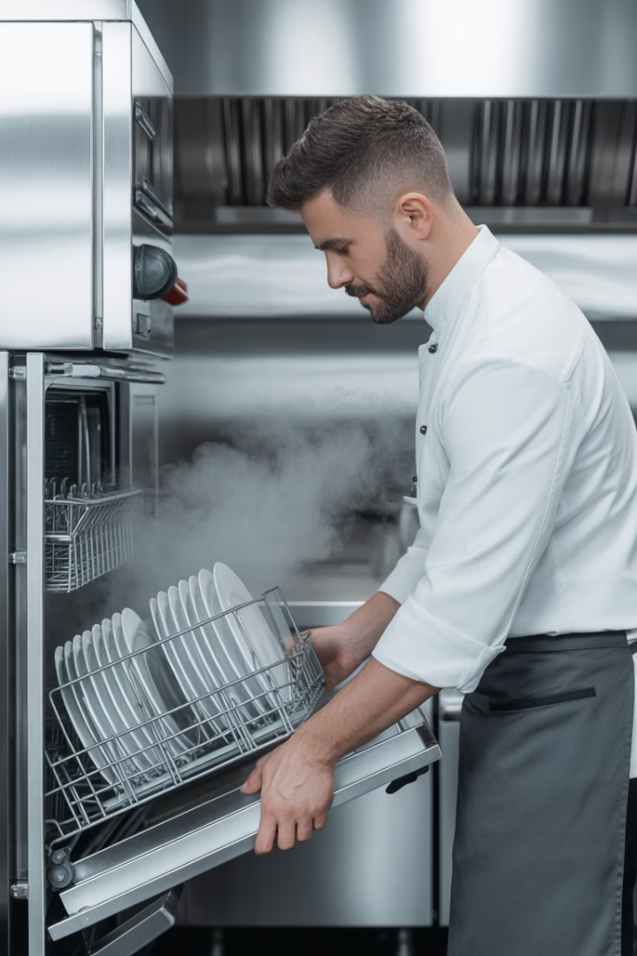
Heat Sanitizing: When and How
Temperature Requirements
Common Applications
Water must reach at least 171°F (77°C) for minimum 30 seconds.
Three-compartment sinks and high-temperature dishwashers.
Safety Considerations
Use thermometers to verify temperatures. Protect hands from hot surfaces.

Slide 6
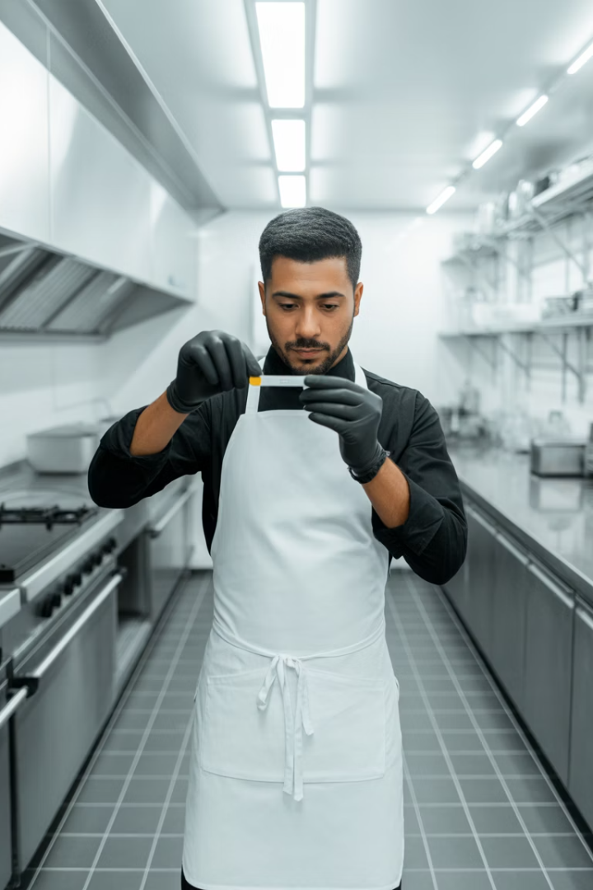
Chemical Sanitizing Options
Chlorine
Fast-acting. 50-100 ppm. Minimum 75°F. At least 7 seconds contact time.
Iodine
Effective at low pH. 12.5-25 ppm. Minimum 68°F. At least 30 seconds contact.
Quats
Stable and non-corrosive. Concentration per manufacturer. At least 30 seconds contact.

Slide 7
Ensuring Sanitizer Effectiveness
Proper Concentration
Use test kits to measure parts per million (ppm).
Correct Temperature
Follow manufacturer's guidelines for each sanitizer type.
Water Hardness Adjustment
Hard water reduces effectiveness of many sanitizers.

Slide 8
The 5-Step Cleaning and Sanitizing Process
Scrape or Remove Food
Clear all visible food particles and debris from the surface.
Wash Surface
Apply detergent with hot water and scrub to remove soils.
Rinse Thoroughly
Use clean water to remove all detergent and loosened soil.
Apply Sanitizer
Use chemical solution or heat to sanitize the clean surface.
Air Dry
Allow surface to air dry completely. Never use towels.

Slide 9
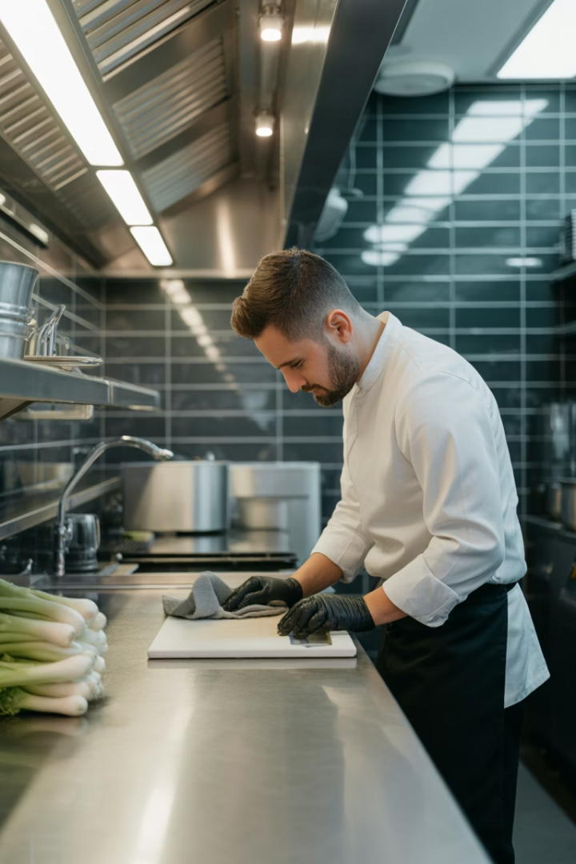
When to Clean and Sanitize
After Each Use
Between Food Types
After Interruptions
Clean and sanitize equipment and surfaces after completing tasks.
Always sanitize before switching from raw to ready-to-eat foods.
Sanitize if you leave your station to take calls or other tasks.
Every 4 Hours
For items in constant use, clean and sanitize at least every 4 hours.

Slide 10
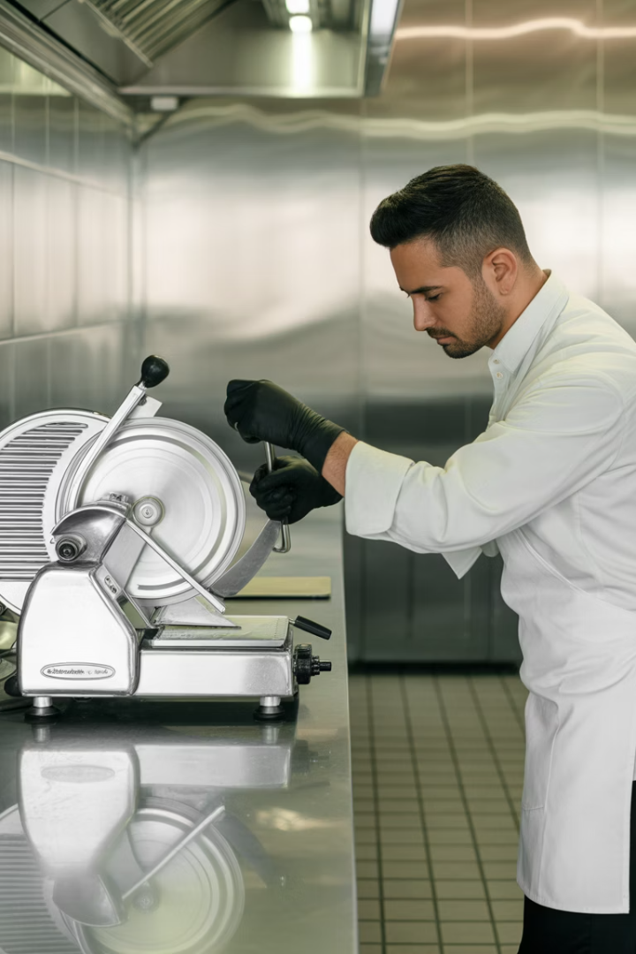
Cleaning Stationary Equipment
Unplug Equipment
Ensure equipment is turned off and disconnected for safety.
Remove Parts
Take off removable parts and clean them separately.
Clean and Sanitize
Scrape, wash, rinse, and sanitize all food-contact surfaces.
Air Dry and Reassemble
Allow parts to dry completely before putting equipment back together.

Slide 11
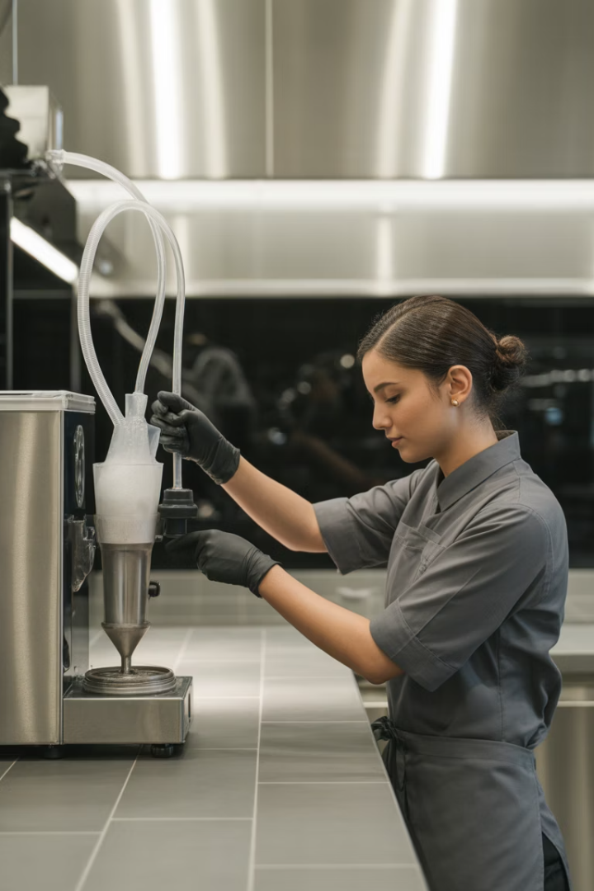
Clean-in-Place (CIP) Equipment
1
Identify CIP Equipment
Soft-serve machines, beverage dispensers, and similar systems require CIP cleaning.
2
Follow Manufacturer Instructions
Each machine has specific cleaning procedures that must be followed exactly.
3
Circulate Solutions
Cleaning and sanitizing solutions must flow through all food-contact parts.
4
Document Completion
Record cleaning activities to demonstrate compliance with food safety protocols.

Slide 12
High-Temperature Dishwashing
Final Rinse Temperature
Must reach 180°F (82°C) to kill pathogens.
Temperature Monitoring
Check built-in thermometers during each shift.
Water Pressure
Maintain proper pressure for effective cleaning.

Slide 13
Chemical-Sanitizing Dishwashers
Wash Temperature
120°F (49°C) minimum
Sanitizer Type
Chlorine, iodine, or quats
Verification Method
Test strips for each load
Maintenance
Daily cleaning of filters and spray arms
Documentation
Log temperature and sanitizer checks

Slide 14
Dishwasher Maintenance
Daily Inspection
Clean Filters
Check spray arms, filters, and wash arms for food debris.
Remove and clean screens and filters after each shift.
Verify Operation
Delime Machine
Test temperature and pressure gauges regularly.
Use delimers to remove mineral buildup weekly or as needed.

Slide 15
Manual Dishwashing: Three-Compartment Sink
Scrape & Rinse
Remove food particles before washing.
Wash (≥110°F)
Use detergent in first sink to clean thoroughly.
Rinse
Use clean water in second sink to remove detergent.
Sanitize
Use chemical sanitizer or hot water in third sink.
Air Dry
Place on clean rack to air dry completely.

Slide 16
Proper Storage of Clean Items
Height Requirement
Glassware Position
Store all items at least 6 inches off the floor.
Store glasses and cups upside down to prevent contamination.
Utensil Handling
Protection
Store utensils with handles up for easy, sanitary retrieval.
Cover items or store in clean, enclosed spaces.

Slide 17
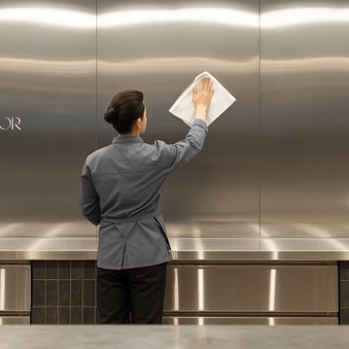
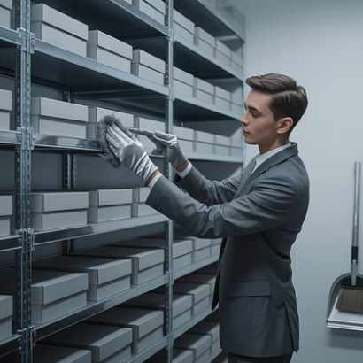
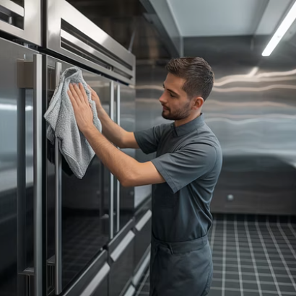
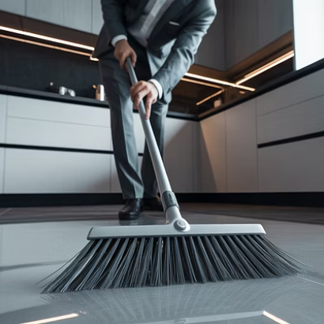
Cleaning Nonfood-Contact Surfaces
Nonfood-contact surfaces need regular cleaning to prevent dirt, dust, and grease buildup. Clean walls, shelves, floors, and equipment exteriors on a scheduled basis.

Slide 18
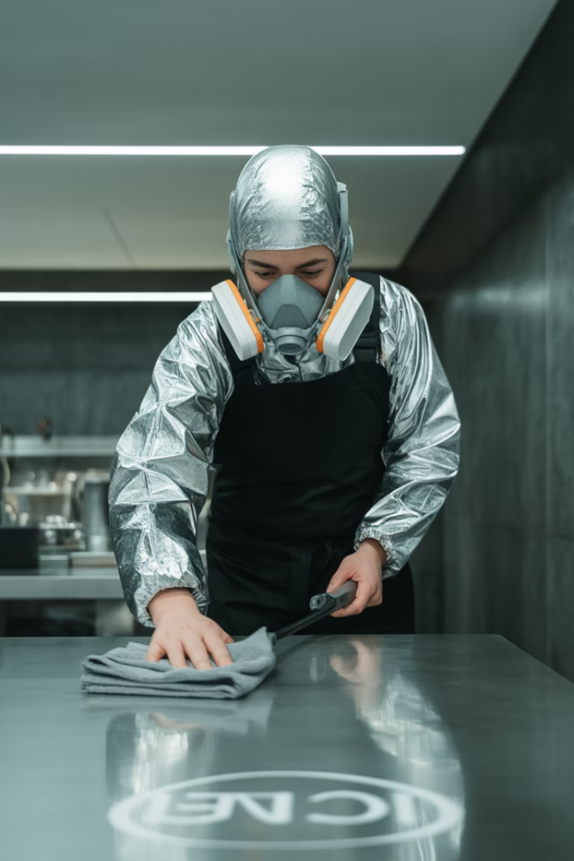
Responding to Vomiting or Diarrhea Incidents
30 ft
5 min
Clearance Zone
Response Time
Clear the area around the incident to prevent cross-contamination.
Begin cleanup within 5 minutes to minimize pathogen spread.
1000 ppm
Chlorine Solution
Use stronger disinfectant concentration for bodily fluid cleanup.

Slide 19
Vomit and Diarrhea Response Plan
Personal Protection
Wear gloves, mask, and disposable apron.
Containment
Use absorbent material and dispose in sealed bags.
Disinfection
Apply EPA-registered disinfectant with extended contact time.
Disposal
Discard exposed food and single-use items.

Slide 20
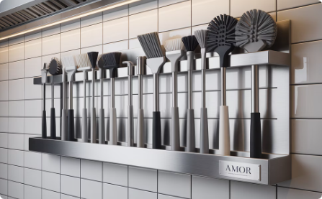
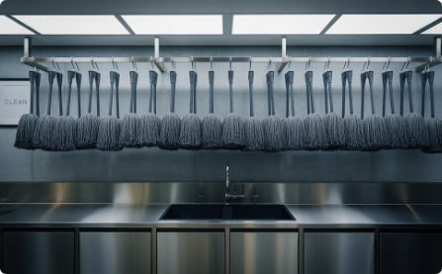
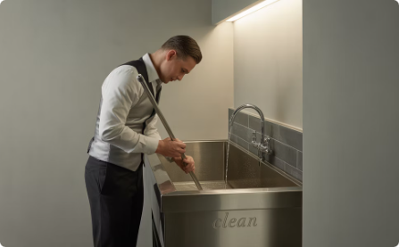
Cleaning Tools and Their Care
Color-Coding System
Use different colored tools for different areas. Red for bathrooms, green for food prep areas.
Proper Storage
Hang mops and brooms upside down. Allow to air dry completely after cleaning.
Tool Maintenance
Clean tools after each use. Replace worn brushes and mop heads regularly.

Slide 21
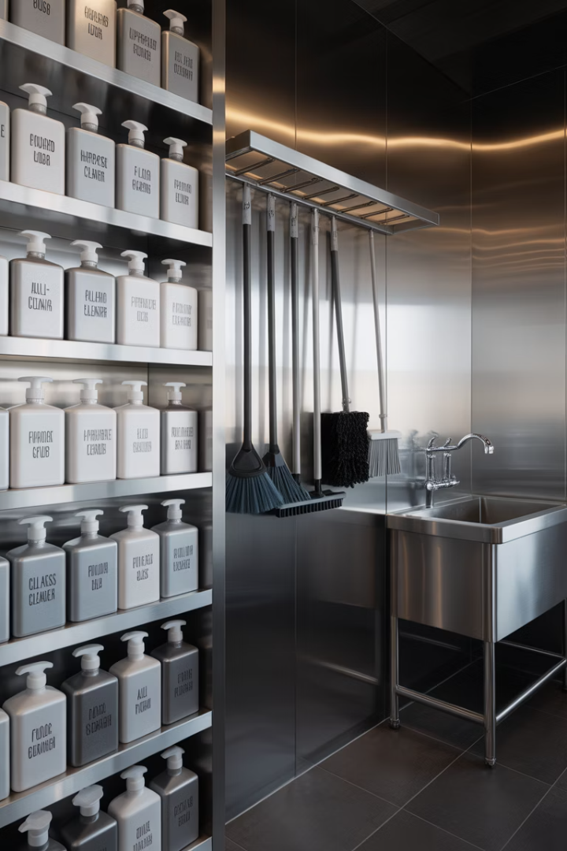
Dedicated Cleaning Supply Storage
Location Requirements
Organization System
Wall-mounted hooks for hanging tools
Away from food preparation areas
Labeled shelves for chemicals
Well-ventilated space
Lockable if possible
Dedicated utility sink
Safety Features
Good lighting
Eye wash station nearby
Safety data sheets accessible

Slide 22
Proper Use of Wiping Towels
Food-Contact Surfaces
Nonfood-Contact Surfaces
Use dedicated towels for food-contact surfaces only.
Use separate towels for cleaning tables, counters, and equipment exteriors.
Store in sanitizer solution between uses.
Store in different sanitizer containers.
Test sanitizer concentration throughout the day.
Use distinct colors to prevent cross-contamination.
Replace towels when they become soiled.
Launder or discard at the end of each shift.

Slide 23
Chemical Safety: Storage and Labeling
Proper Labeling
All chemical containers must be clearly labeled with contents.
Secure Storage
Store chemicals away from food and food preparation areas.
Original Containers
Keep chemicals in original containers whenever possible.

Slide 24
Safety Data Sheets (SDS)
Hazard Identification
First Aid Measures
Handling and Storage
Exposure Controls
Physical Properties
Other Information

Slide 25
Chemical Dilution and Dispensing
Use Dispensing Systems
Follow Manufacturer Instructions
Automatic dispensers ensure accurate dilution of concentrated chemicals.
Using too much chemical wastes money and may be dangerous.
Wear Protective Equipment
Label Secondary Containers
Use gloves and eye protection when handling concentrated chemicals.
Always label spray bottles and buckets with contents and hazards.

Slide 26
Creating a Master Cleaning Schedule
Task
Frequency
Responsibility
Procedure
Clean prep tables
After each use
Line cook
5-step method
Clean floors
End of shift
Closing staff
Sweep, then mop
Clean refrigerator
Weekly
Morning prep
Empty, clean, sanitize
Clean hood filters
Monthly
Kitchen manager
Degrease and wash

Slide 27
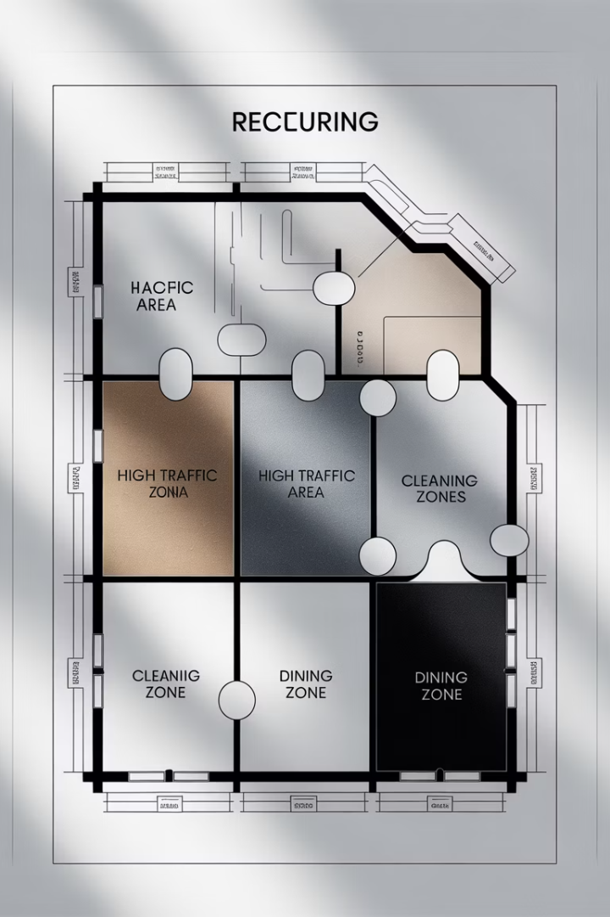
Identifying Cleaning Needs by Area
Kitchen
Dining Area
Restrooms
Equipment, surfaces, floors, walls, hoods, filters, drains.
Tables, chairs, floors, condiment holders, menus, high chairs.
Toilets, sinks, dispensers, floors, walls, mirrors, door handles.
Storage Areas
Shelving, floors, walls, receiving areas, loading docks.

Slide 28
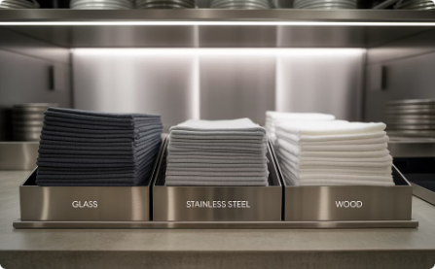
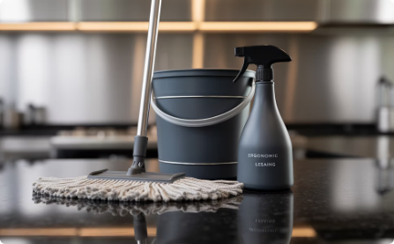
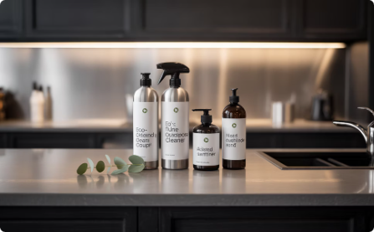
Choosing the Right Cleaning Materials
Microfiber Technology
Microfiber cloths trap more dirt and bacteria than cotton. Use color-coded systems to prevent cross-contamination.
Ergonomic Tools
Choose tools designed to reduce worker fatigue. Adjustable handles and lightweight designs improve efficiency.
Eco-Friendly Options
Consider environmentally safe cleaning products. They protect workers and reduce environmental impact.

Slide 29
Implementing Your Cleaning Program
Review and Improve
Document Activities
Monitor Compliance
Regularly evaluate your program and make adjustments as needed.
Train All Staff
Keep records of cleaning tasks, chemical tests, and any corrective actions.
Ensure everyone understands proper procedures and the importance of following them.
Use checklists and regular inspections to verify tasks are completed correctly.

Slide 30
Key Takeaways: Clean, Safe Food Environments
2
5
Distinct Processes
Step Process
Always remember that cleaning and sanitizing are separate, essential steps.
Follow the complete process: scrape, wash, rinse, sanitize, air dry.
4
100%
Hour Rule
Compliance
Clean and sanitize food contact surfaces at least every 4 hours.
Food safety depends on consistent application of these principles.

