Slide 1
Integrated Pest Management: A Comprehensive Guide
Welcome to our complete guide on Integrated Pest Management (IPM) for food service operations. This presentation will help you implement effective strategies to keep your establishment pest-free and compliant with health regulations.

Slide 2
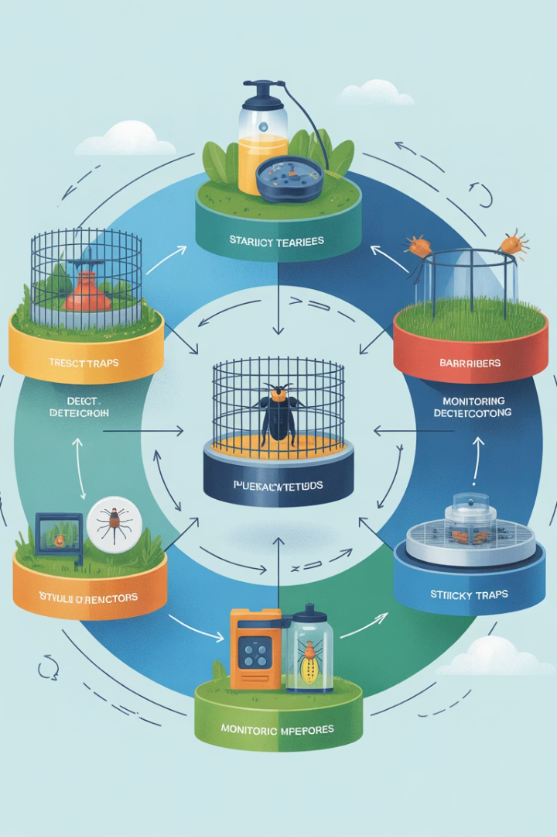
What is Integrated Pest Management?
Prevention
Block pest entry points and eliminate attractants
Monitoring
Regular inspection for early detection
Control
Targeted methods to eliminate pests
Evaluation
Assess effectiveness and adjust strategies

Slide 3
Three Pillars of Effective IPM
Work with licensed PCOs
Expert partnerships for compliance
Deny food, water & shelter
Remove what pests need to survive
Deny access to facility
Keep pests out completely

Slide 4
Monitoring Deliveries
Inspect Every Package
Reject Compromised Items
Check all deliveries thoroughly before bringing them inside.
Look for gnaw marks, droppings, or insects.
Proper Storage
Keep deliveries off floors and away from walls.

Slide 5
Securing Entry Points: Doors & Windows
Keep Closed When Not In Use
Doors and windows should remain shut unless actively in use.
Self-Closing Devices
Install on all exterior doors and between kitchen and restrooms.
Air Curtains
Create invisible barriers that push flying insects out.
Weather Stripping
Seal gaps around door frames and window edges.

Slide 6
Proper Screening
Mesh Requirements
Critical Areas
Maintenance
Use screens with at least 16 mesh per inch.
Windows
Check regularly for tears, holes, or gaps.
Exterior vents
Finer mesh prevents even the smallest insects from entering.
Exhaust fans
Replace damaged screens immediately.
Air intakes

Slide 7
Sealing Building Exterior
Inspect
Examine building exterior for cracks, holes, and gaps.
Seal
Use appropriate materials to close all openings.
Secure Pipes
Seal around utility lines where they enter building.
Regular Maintenance
Schedule quarterly inspections to maintain integrity.

Slide 8
Floor Drain Protection
Tight-Fitting Grates
Regular Cleaning
Cover all floor drains with secure grates.
Clean drains weekly to prevent buildup.
Regular Inspection
Maintenance
Check for signs of pest activity near drains.
Repair broken grates immediately.

Slide 9
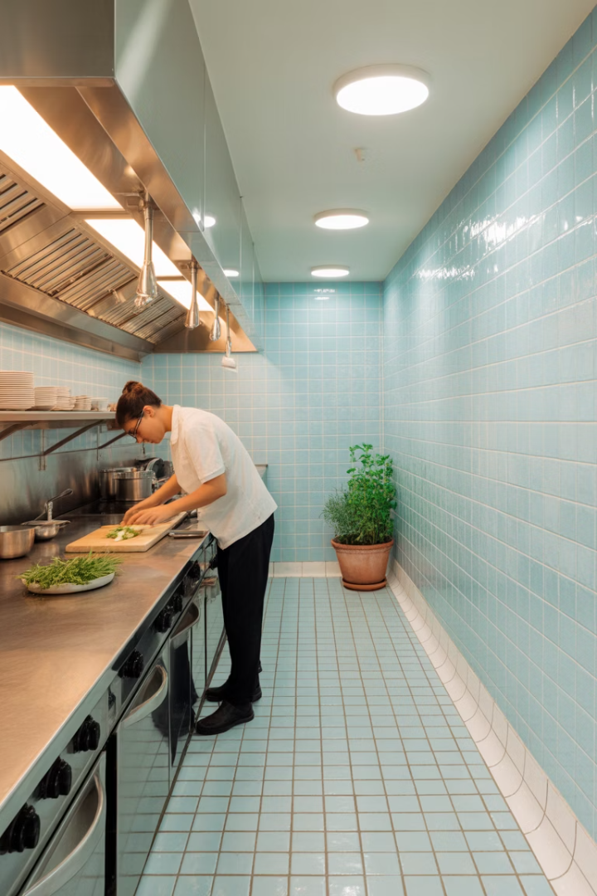
Floor and Wall Integrity
1
Repair All Cracks
Fix any breaks in floors, walls, or ceilings promptly.
2
Seal Baseboards
Maintain tight seals where floors meet walls.
3
Fill Holes
Patch even tiny openings that could admit pests.
4
Schedule Inspections
Check facility integrity monthly.

Slide 10
Waste Management
Frequent Removal
Remove garbage from prep areas immediately. Empty indoor containers often.
Proper Container Use
Use leak-proof, durable containers with tight-fitting lids.
Cleaning Schedule
Clean and sanitize garbage containers regularly.
Outdoor Management
Keep dumpsters closed and away from building entrances.

Slide 11
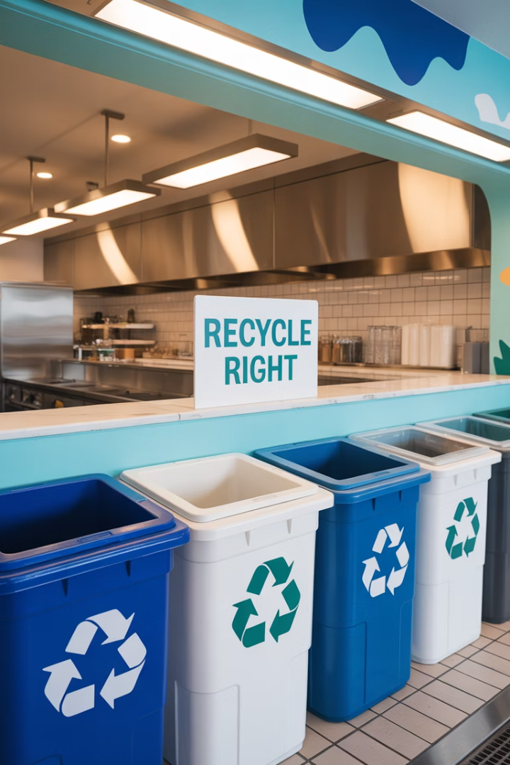
Managing Recyclables
Dedicated Area
Regular Cleaning
Covered Storage
Store recyclables away from food preparation zones.
Rinse containers and clean storage areas daily.
Keep materials in closed, pest-resistant containers.
Frequent Pickup
Schedule regular collection to prevent accumulation.

Slide 12
Proper Food Storage
6
Inches Off Floor
Minimum height for all stored items
6
Inches From Wall
Required space between stored items and walls
1st
In, First Out
FIFO rotation system prevents old stock
41°F
Or Below
Ideal temperature for refrigerated storage

Slide 13
Cleaning Protocols
Immediate Spill Response
Clean all spills as they happen
Daily Cleaning Schedule
Regular attention to all areas
Deep Cleaning Program
Thorough cleaning of hard-to-reach spots

Slide 14
Exterior Grounds Maintenance
Landscaping
Water Management
Outdoor Dining Areas
Mow grass regularly
Eliminate standing water
Clean tables and chairs daily
Trim shrubs away from building
Fix leaky outdoor faucets
Use approved pest barriers
Remove weeds promptly
Ensure proper drainage
Empty trash frequently

Slide 15
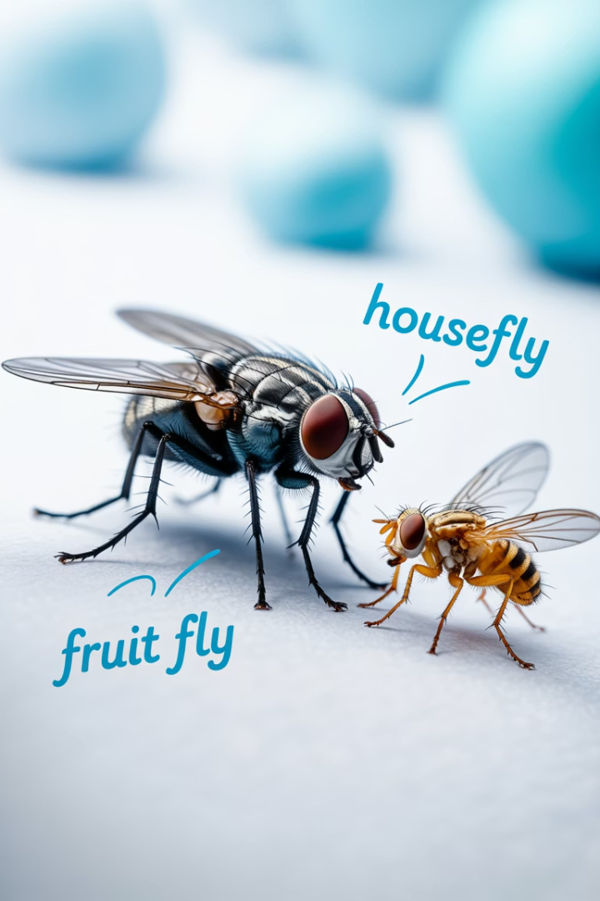
Identifying Common Flies
Type
Appearance
Habitat
Signs
Houseflies
Gray, 1/4 inch
Garbage, food waste
Flying insects, buzzing
Fruit Flies
Tan/brown, tiny
Produce, drains
Swarms near fruit, beverages
Drain Flies
Moth-like, fuzzy
Drains, moist areas
Near sinks, floor drains

Slide 16
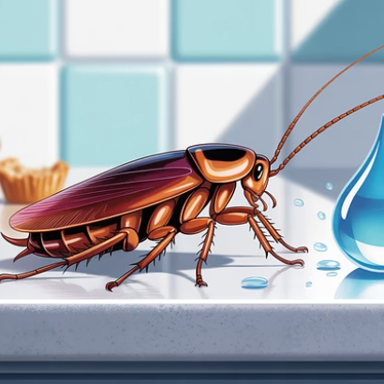
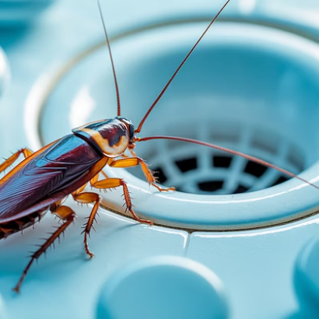
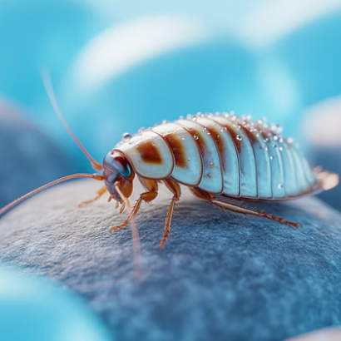
Cockroach Identification
Cockroaches are nocturnal, preferring dark, warm, moist areas. Look for droppings resembling black pepper, egg cases, and a distinct oily odor.

Slide 17
Rodent Recognition
Rats
Mice
Warning Signs
Larger bodies (7-10 inches) with blunt snouts and thick tails.
Smaller bodies (2-4 inches) with pointed snouts and thin tails.
Droppings near food areas
Gnaw marks on packages
Leave larger droppings
Leave rice-sized droppings
Grease marks along walls
Can climb and swim
Excellent climbers
Nesting materials
Require larger entry points
Can squeeze through dime-sized holes
Scratching sounds

Slide 18
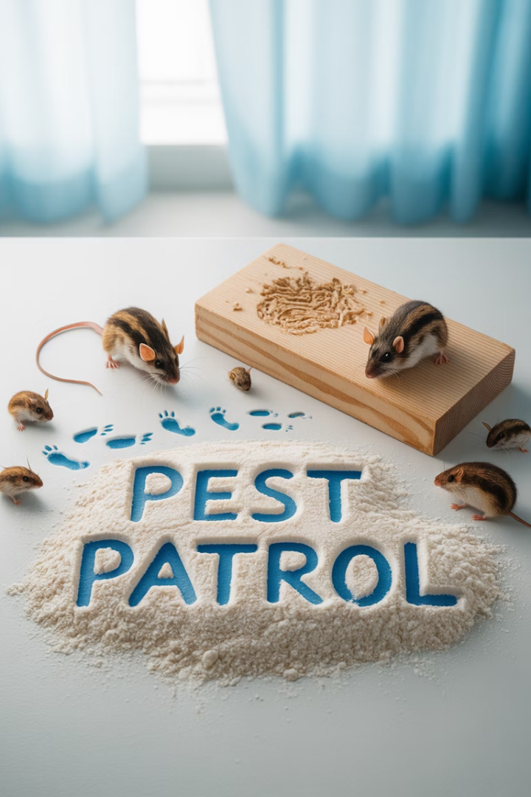
Signs of Pest Infestation
Droppings
Look near walls, in drawers, and under equipment.
Gnaw Marks
Check packaging, wires, and wooden structures.
Unusual Odors
Notice musty, oily, or ammonia-like smells.
Nesting Materials
Shredded paper, fabric, or insulation in corners.

Slide 19
Working with Pest Control Operators
Selection
Inspection
Choose licensed, insured PCOs with foodservice experience
Schedule comprehensive facility assessment
Monitoring
Treatment Plan
Review service reports and evaluate effectiveness
Review proposed IPM strategies and schedules

Slide 20
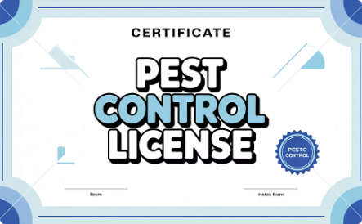
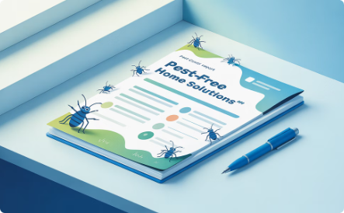
Choosing the Right PCO
Verify Credentials
Ensure proper licensing and certification for your state.
Check Experience
Ask for references from other foodservice clients.
Review Documentation
Evaluate sample reports and treatment plans.

Slide 21
Effective Pest Treatment Approaches
Non-Chemical Methods First
Start with traps, barriers, and sanitation
Targeted Applications
Use precise treatments for specific pests
Minimal Chemical Use
Apply least toxic effective options

Slide 22
Safe Pesticide Application
Pre-Application
Remove or cover all food
Cover food-contact surfaces
Clear treatment areas
Post required notices
During Application
Only licensed PCOs apply pesticides
Staff should vacate treatment areas
Ensure proper ventilation
Post-Application
Wait specified reentry period
Clean and sanitize surfaces
Document application details

Slide 23
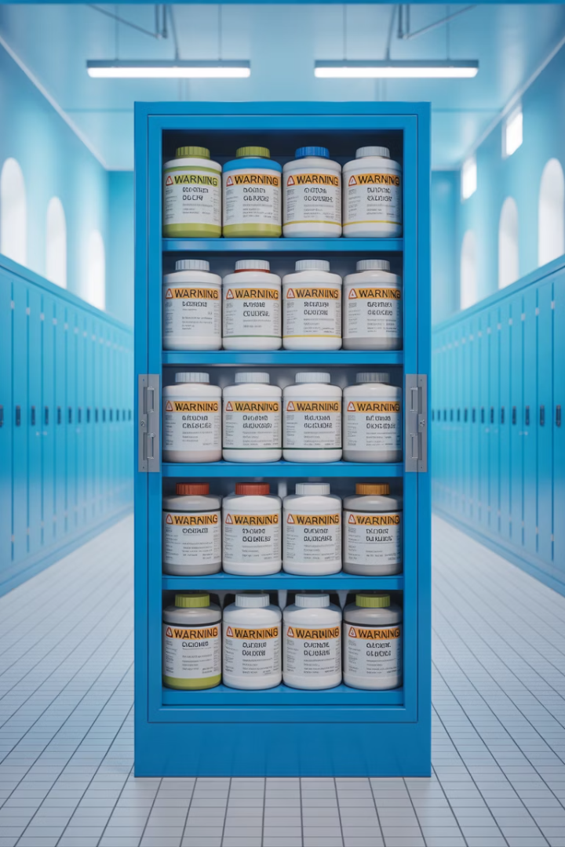
Pesticide Storage and Disposal
Original Containers Only
Never transfer pesticides to unmarked bottles. Keep original labels intact.
Secure Storage
Store in locked cabinets away from food, utensils, and preparation areas.
Inventory Management
Track usage and disposal dates. Minimize quantities stored on-site.
Proper Disposal
Follow label instructions and local hazardous waste regulations.

Slide 24
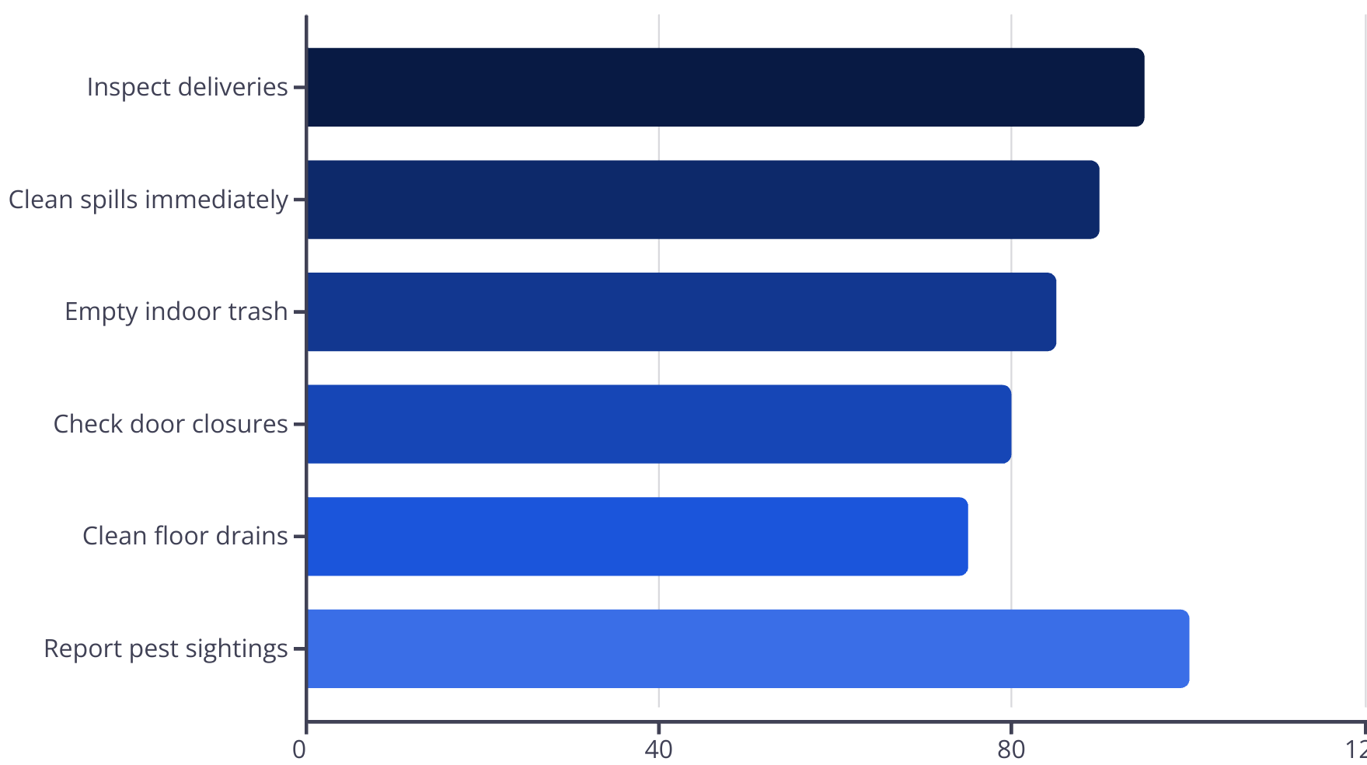
Daily IPM Checklist

Slide 25
IPM Program Success
Pest-Free Environment
Safe food, satisfied customers
Regular Monitoring
2
Prevention through vigilance
Staff Participation
Everyone contributes to success
Implementing a comprehensive IPM program protects your business, customers, and reputation. Consistent application of these practices will ensure long-term success in pest prevention.

